Slide 1

A Presentation on the Mini Project topic of
“Cyberbullying Detection on Text and Images Using Machine Learning Algorithms”
Presented by MANOHAR SINGH & MANISH BAILWAL COURSE -: B.TECH(CSE) SECTION -: S SEMESTER -: VI
SESSION-: 2023-24

Slide 2
PROJECT CONTENT
INTRODUCTION
LIBRARIES AND DEPENDENCIES
DATA COLLECTION AND PREPROCESSING
MODEL TRAINING AND EVALUATION
EXPLORATORY DATA ANALYSIS
USER INTERFACE WITH STREAMLIT
RESULT AND PREDICTIONS
CONCLUSION

Slide 3
Introduction
This project focuses on detecting cyberbullying and hate speech in text data using advanced machine learning techniques. Given the increasing prevalence of harmful online interactions, it is crucial to develop automated tools to identify and mitigate such content to maintain safer online environments.
Problem Addressed: Increasing prevalence of harmful online interactions.
Goal: Develop automated tools to identify and mitigate harmful content, ensuring safer online environments.
Web Interface: Allows users to input text or upload images.
Analyzes input for harmful content.
Provides immediate feedback and intervention.
Application:
Supports social media platforms, forums, and online communities in promoting respectful and positive communication.
Solution Benefits:
Scalable and effective detection process.
Contributes to a safer and more inclusive online experience for all users.

Slide 4
Libraries & Dependencies Used
pandas: Used for data manipulation, such as loading and cleaning the dataset.
matplotlib: Creates plots and graphs for data visualization.
seaborn: Enhances the aesthetics of matplotlib plots.
wordcloud: Generates visual representations of word frequencies.
nltk: Provides tools for text preprocessing, including tokenization, lemmatization, and stopword removal.
scikit-learn: Offers various algorithms for machine learning, model evaluation, and text vectorization.
textblob: Performs sentiment analysis on text data.
scipy: Supports scientific calculations and sparse matrices.
imbalanced-learn: Addresses class imbalance in datasets using techniques like SMOTE.
streamlit: Develops interactive web applications for the project.
pytesseract: Extracts text from images using OCR.
PIL: Handles image file operations and preprocessing.

Slide 5
Data Collection & Preprocessing
Description of the Dataset
The dataset consists of tweets that are unlabeled and contains four columns(tweet id, source of tweet , tweet, type of tweet[positive, negative, neutral, irrelevant]).
Steps in Data Cleaning and Preprocessing
Load the dataset using pandas.
Drop rows with missing values and remove duplicates.
Convert all text to lowercase.
Remove URLs, HTML tags, special characters, and retweet tags.
Tokenize text and remove stopwords.
Lemmatize the words to their base forms.

Slide 6
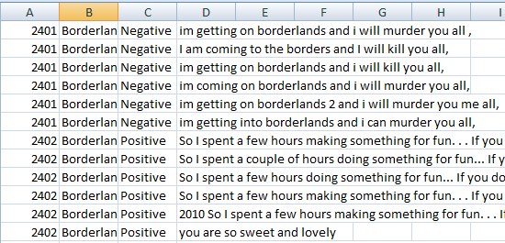
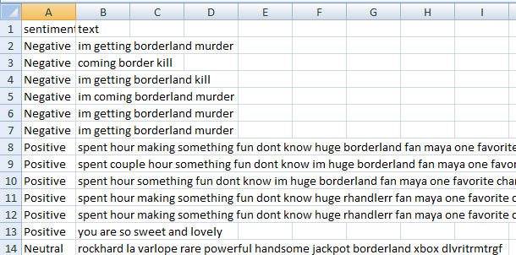
Before and After Preprocessing the dataset:
Raw dataset -: twitter_training.csv
Pre processed dataset -: preprocessed_twitter_training.csv

Slide 7
Model training & evaluation
Machine Learning Models Used:
RandomForest: Ensemble method that uses multiple decision trees for classification.
SVM: Support Vector Machine, effective for high-dimensional spaces.
KNN: K-Nearest Neighbors, a simple, instance-based learning algorithm.
DecisionTree: A model that uses a tree-like graph for decisions.
AdaBoost: Adaptive Boosting, combines weak classifiers to form a strong classifier.
LogisticRegression: Statistical model that in its basic form uses a logistic function to model a binary dependent variable.
NaiveBayes: Probabilistic classifier based on Bayes' theorem.
GradientBoosting: Builds models sequentially to correct errors of previous models.

Slide 8
Training Process :
Data Splitting:
Description: The dataset is divided into training and testing sets to evaluate model performance.
Method: Typically, an 80-20 or 70-30 split is used.
Training Each Model:
Process: Each machine learning model is trained on the training set. 2.
Metrics Used : Parameters and hyper parameters are tuned to improve performance.
Evaluating Model Performance:
Accuracy: Measures the proportion of correctly classified instances.
Precision: Measures the proportion of true positives out of the total predicted positives.
Recall: Measures the proportion of true positives out of the total actual positives.
F1-Score: Harmonic mean of precision and recall, useful for imbalanced datasets.

Slide 9


Results :
Model Performance Comparison:
Description: A comparative analysis of the performance metrics for each model.
Objective: Identify the model that best balances accuracy, precision, recall, and F1-score.
Selection of the Best Model:
The model with the highest performance metrics (e.g., highest F1-score, accuracy) is selected for deployment.
Output of train_models.py :

Slide 10
Exploratory data analysis(eda)
Sentiment Distribution:
Visualizes the distribution of different sentiment labels in the dataset.
Helps understand the balance of the dataset.
Word Clouds:
Visual representation of the most common words in the dataset.
Separate word clouds for different sentiments to identify common words in each category.
Text Length Distribution:
Analysis of the length of tweets in terms of the number of words.
Visualizes the distribution of text lengths.
Sentiment-wise Text Length Distribution:
Boxplot visualization showing the distribution of text lengths across different sentiments.
Helps understand if certain sentiments tend to have longer or shorter tweets.

Slide 11
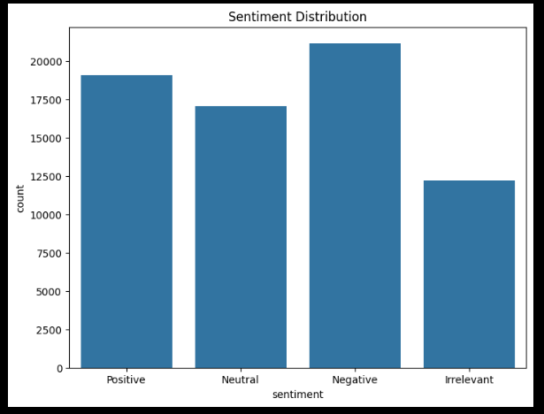
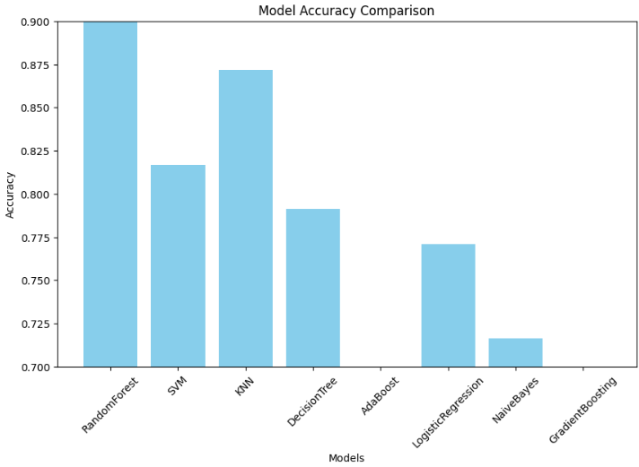
BAR CHART OF SENTIMENT DISTRIBUTION AND MODEL ACCURACY COMPARISON

Slide 12
USER INTERFACE WITH STREAMLIT
Overview of the Web Application:
Built using Streamlit, a framework for creating interactive web applications.
Provides an easy-to-use interface for predicting sentiment.
Features:
Text Input: Allows users to input text for sentiment analysis.
Image Upload: Users can upload images containing text for sentiment analysis using OCR.
Prediction Display: Shows the predicted sentiment of the input text or extracted text from the image.

Slide 13
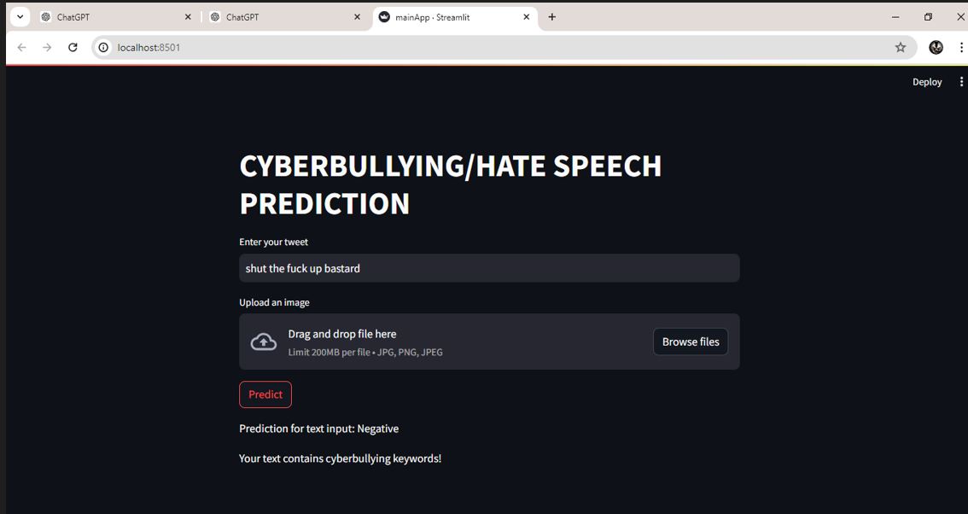
USER INTERFACE

Slide 14
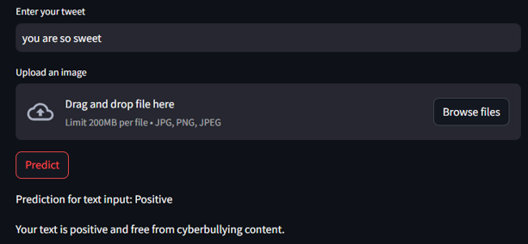
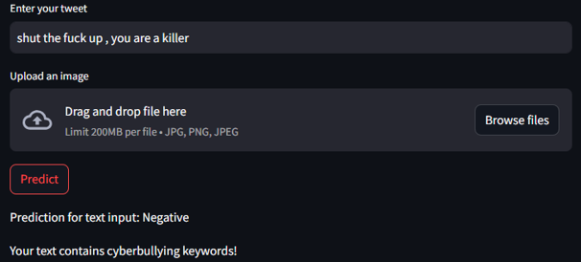
SOME TEXT AND IMAGE INPUTS AND THEIR OUTPUTS

Slide 15
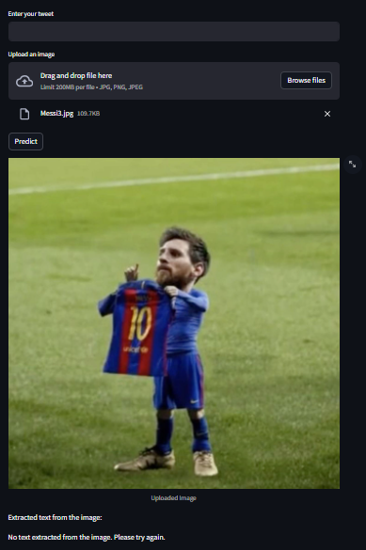
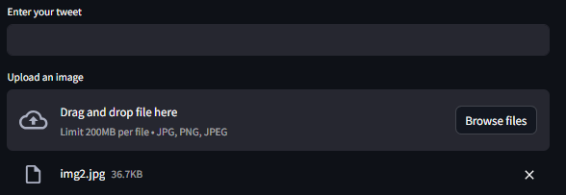
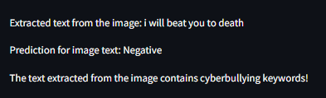
SOME TEXT AND IMAGE INPUTS AND THEIR OUTPUTS

Slide 16
conclusion
Summary of the Project:
Recap of key steps: data preprocessing, model training, evaluation, and deployment.
Emphasis on the importance of detecting cyberbullying and hate speech.
Key Takeaways:
Importance of text preprocessing in improving model performance.
Effectiveness of ensemble methods like RandomForest and GradientBoosting.
Future Improvements and Next Steps:
Integration of more advanced models like BERT.
Enhancement of the user interface.
Real-time analysis and deployment on larger datasets.

Slide 17
END OF THE PPT
THANK YOU
THANK YOU

